Slide 1
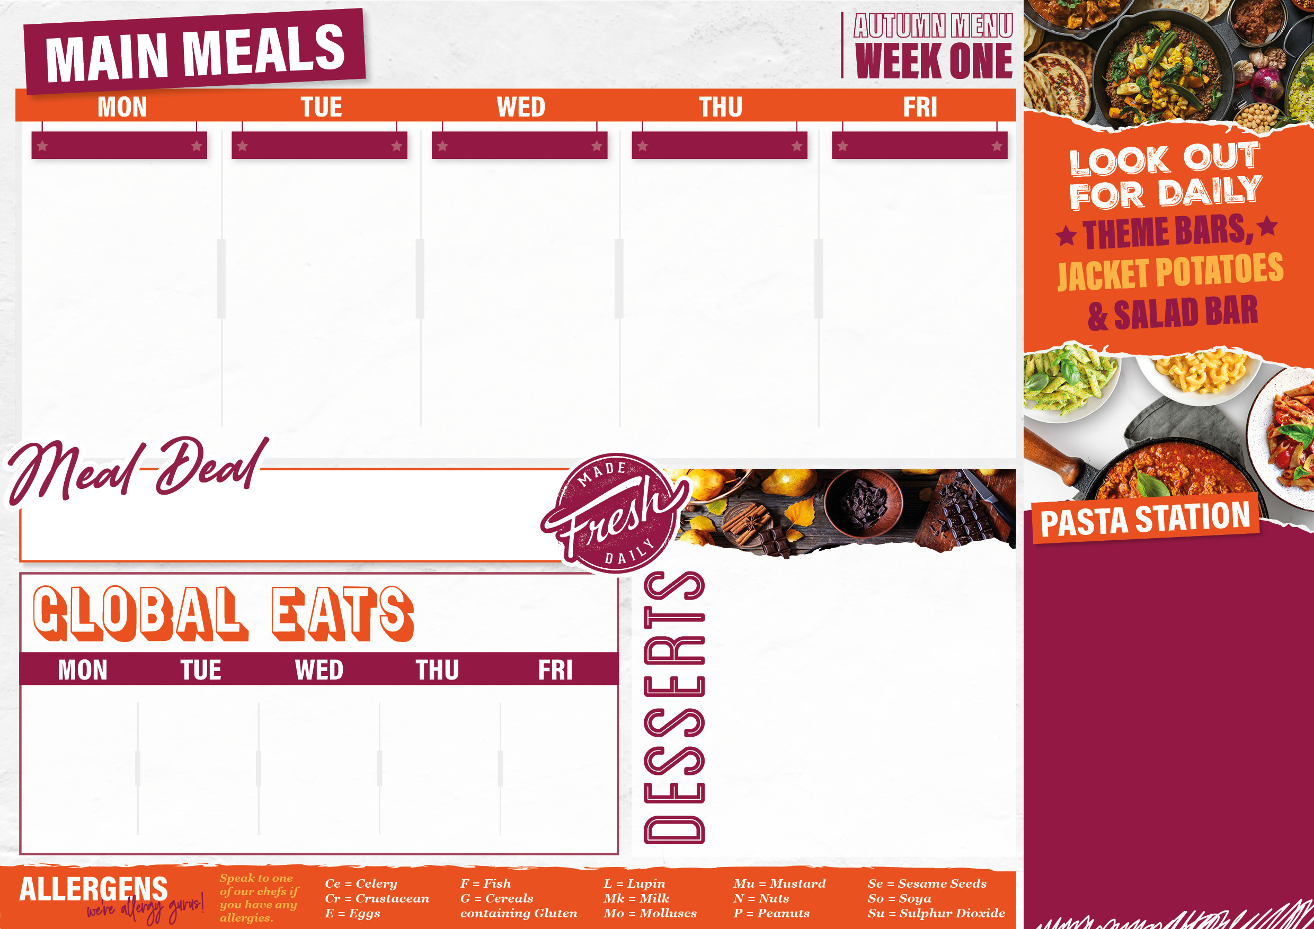
01/09/25,22/09/25
20/10/25,17/11/25
08/12/25
From £1.60
ORIENTAL FLAVOURS
HOME COMFORTS
ROAST
TASTE OF JAMAICA
FISH & CHIP SHOP
Chicken Stir-Fry (G,So) Sticky Teriyaki Eat Curious Stir Fry (G,So) Soy & Ginger Noodles (E,G,So) Roasted Chinese Leaf & Cabbage (G,So) | Cottage Pie(Ce,G,Mk,So) Vegetarian Cottage Pie(Ce,So) Peas and Sweetcorn | Roast Turkey with Stuffing & Herb Gravy (G) Creamy Butternut & Vegetable Pie With Crunchy Crust (G,Mk) Crunchy Roast Potatoes Savoy Cabbage & Carrots | Jamaican Jerk Chicken with Jerk Gravy Jamaican Jerk Eat Curious with Jerk Gravy Coconut Rice & Peas Caribbean Coleslaw (E,Mk,So) | Battered Fish Fillet (G,F) Crispy Chicken Tenders (G,Ce,Mk,Mu,So) Cheese & Onion Pasty (G,Mk) Chips Peas Baked Beans
Only £2.40
Check out what’s on offer today, available for free school meals!
MONDAY
Double Chocolate Pudding (G,E,Mk,So)
TUESDAY
Berry Flapjack Crumble (G)
WEDNESDAY
Toffee & Banana Cake (G,E,Mk,So)
THURSDAY
Lemon & Blueberry Sponge (G,E)
FRIDAY
Sticky Ginger Cake (G,E,Mk)
MONDAY
Tomato and Basil Sauce (G), Macaroni Cheese (G,Mk)
TUESDAY
Tomato and Basil Sauce (G), Cheese and Tomato Pasta Bake (G,Mk)
WEDNESDAY
Tomato and Basil Sauce (G), Bolognaise (G)
THURSDAY
Tomato and Basil Sauce (G), Macaroni Cheese (G,Mk)
FRIDAY
Tomato and Basil Sauce (G)
From £1.60
Pizza Panini(G,Mk) | Mexican Chicken Panini (G,Mk,So) | Beef Jamaican pattie (G) | Cheesy BBQ Loaded Fries with Crispy Onions (G,Mk) | Margarita Pizza (G,Mk,So)
From £1.60
From £1.60

Slide 2

08/09/25,06/10/25
03/11/25,24/11/25
15/12/25
From £1.60
TASTE OF ITALY
KATSU KITCHEN
HOME COMFORTS
CLASSIC
FISH & CHIP SHOP
Penne Bolognaise Pasta Bake and Garlic Bread (G,Mk,So) Baked Gnocchi with Creamy Spinach and Garlic Bread (G,E,Mk,Mu,So) Steamed Seasonal Greens | Crispy Chicken Katsu (G,E) with Curry Sauce (G,So) Crispy Sweet Potato Katsu (G,E) with Curry Sauce (G,So) Steamed Rice Asian Salad | Butchers Sausages with Caramelised Onion Gravy (G,Su) Grilled Veggie Sausages with Caramelised Onion Gravy (G,Ce) Creamy Mashed Potatoes Roasted Broccoli | Slow Cooked Beef Lasagne(G,E,Mk) with Garlic Bread (G,Mk,So) Mediterranean Roasted Vegetable Lasagne(G,Mk,E) with Garlic Bread (G,Mk,So) | Battered Fish Fillet (G,F) Baked Sausage Roll (G,Mk,So,Su) Crispy Vegetable Spring Rolls with Curry Sauce (G,Mk,Se,So) Chips Peas Baked Beans
Only £2.40
Check out what’s on offer today, available for free school meals!
MONDAY
Pineapple Upside Down Sponge (G,E,Mk,So,Su)
TUESDAY
Berry Mess Cup Cakes (G,E)
WEDNESDAY
Caramel Apple Shortbread Crumble and Custard (G,E,Mk,So)
THURSDAY
Frosted Carrot & Orange Cake (G,E,Mk)
FRIDAY
Chocolate Brownie (G,E)
MONDAY
Tomato and Basil Sauce (G), Macaroni Cheese (G,Mk)
TUESDAY
Tomato and Basil Sauce (G), Cheese and Tomato Pasta Bake (G,Mk)
WEDNESDAY
Tomato and Basil Sauce (G), Bolognaise (G
THURSDAY
Tomato and Basil Sauce (G), Macaroni Cheese (G,Mk)
FRIDAY
Tomato and Basil Sauce (G)
From £1.60
Blackened Cajun chicken baguette with garlic sauce & salad (E,G,MU) | Margarita pizza (G,MK) | Mediterranean chicken wrap mint & yogurt dressing (E,G,MK) | Cheesy Pepperoni Tater Tots (G,Mk) | Crunchy Fish Finger Wrap with Tartare Sauce (G,E,F)
From £0.95
From £1.60

Slide 3

15/09/25,13/10/25
10/11/25,1/12/25
From £1.60
BURGER BAR
GREEK GYROS
ROAST
PIE & MASH
FISH & CHIP SHOP
Quarter Pound Beef Burger in a Bun (G,Se,Su,So) or Hot Honey Chicken Burger in a Bun (G,Se) Crispy Falafel Burger in a Bun (G,Se) Oven Baked Wedges Crunchy Seasonal Salad | Chicken Gyros with Yoghurt & Mint & Chilli Sauce (G,E,Mk) Sweet Potato Falafel Gyros with Yoghurt & Mint & Chilli Sauce (G,E,Mk) Greek Cabbage Salad Seasoned Potato Wedges | Roast Chicken with Stuffing & Herb Gravy (G) Roast Root Vegetable Wellington with Stuffing & Herb Gravy (G,E,So) Crunchy Roast Potatoes Roasted Carrots & Parsnips | Chicken Balti Pie with Spicy Onion Gravy (G) Veggie Samosa Pie with Spicy Onion Gravy (G) Masala Mashed Potatoes (G) Roasted Aromatic Cauliflower | Battered Fish Fillet (G,F) Crispy Chicken Tenders (G,Ce,Mk,Mu,So) Crispy Vegetable Samosa with Mango Chutney (G,Mu) Chips Peas Baked Beans
Only £2.40
Check out what’s on offer today, available for free school meals!
MONDAY
Autumn Pear & Berry Crumble with Custard (G,E,Mk,So)
TUESDAY
Tip to Toe Banana & Chocolate Brownie (G,E,Mk,So)
WEDNESDAY
Lemon & White Chocolate Drizzle Cake (G,E,Mk,So)
THURSDAY
Sticky Toffee Pudding (G,E,Mk,Su)
FRIDAY
Choc Chip Shortbread (G,Mk,So)
MONDAY
Tomato and Basil Sauce (G), Macaroni Cheese (G,Mk)
TUESDAY
Tomato and Basil Sauce (G), Cheese and Tomato Pasta Bake (G,Mk)
WEDNESDAY
Tomato and Basil Sauce (G), Bolognaise (G
THURSDAY
Tomato and Basil Sauce (G), Macaroni Cheese (G,Mk)
FRIDAY
Tomato and Basil Sauce (G)
From £1.60
Lemon & herb chicken wrap with thai sweet chilli sauce (G) | Hot Dogs with Mustard and Pickled Red Onions (G,Mu,Se,Su) | Margarita Pizza (G,Mk,So) | Piri piri chicken baguette with spicy mayonnaise & salad (E,G) | Spicy Beef pizza (G,Mk)
From £0.95
From £1.60

