Slide 1
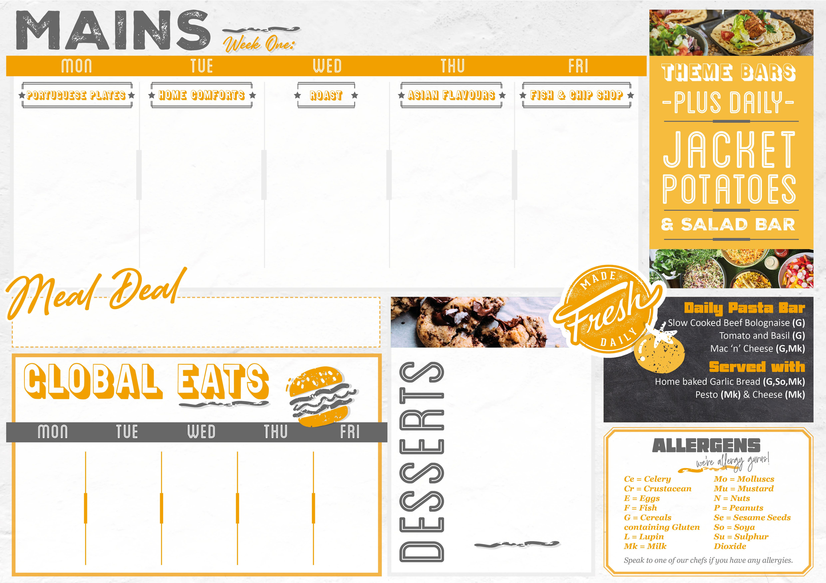
From £1.60
21/4/25,12/5/25,,9/6/25,30/6/25
Peri-Peri Chicken with Lemon & Herb Sauce (E) Peri Peri Caulflower with Lemon & Herb Sauce (E) Spicy Wedges (Mu,G) Crushed Minty Peas | Beef Lasagne with Garlic Bread and Salad (G,So,Mk,E) Mediterranean Roasted Vegetable Lasagne with Garlic Bread and Salad (G,So,Mk,E) | Roast Chicken Dinner with Stuffing & Chicken Gravy (G) Creamy Butternut Pie with Crunchy Crust(G,Mk) Crunchy Roast Potatoes Spring Cabbage and Carrots | Eat Curious Beef Enchilada with Spicy Tomato (G,Mk,Mu) Mixed Bean and Vegetable Enchilada with Spicy Tomato Sauce (G,Mk,Mu) Spicy Rice (Ce) Mexican Slaw (E,Mu) | Battered Fish Fillet (G,F) Sausage Roll (G,Su,Mk,So) Cheese and Onion Pattie (G) Chips Baked Beans
Only £2.40
Check out what’s on offer today, available for free school meals!
MONDAY
Lemon Blondie (G,E)
TUESDAY
Lemon and Ginger Shortbread (G)
WEDNESDAY
Jamaican Ginger Cake (G,E,Mk)
THURSDAY
Chocolate Sponge Pudding (G,E,Mk,So)
FRIDAY
Dorset Apple Cake (Mk,E,G)
From £1.85
Lamb Jamaican Pattie (G) £2.10 | Blackened Cajun Chicken Baguette with Sweet Chilli Sauce (G,Mu) £2.50 | Piri Piri Chicken Wrap with BBQ Sauce (G) £1.60 | Mediterranean Chicken Baguette with Garlic Mayo (G,Se,Mk) £2.50 | Chicken Burger with Mayonaise (Mk) £1.60
From £0.95

Slide 2

From £1.60
28/4/25,19/5/25,16/6/25,7/7/25
Chilli Con Carne with Sour Cream and Pico De Gallo (Mu,Mk) Eat Curious Smoky Veggie Chilli with Pico De Gallo (Mu,Ce) Spring Onion Rice Roasted Corn and Pepper Salad(G,So) | Mildly Spiced Chicken and Olive Tagine with Harissa Yoghurt (Mk,So,G)) Sweet Potato and Butternut Tagine with Harissa Yoghurt (G,Su,Mk) Herby Cous Cous (G,Mu,So) Moroccan Carrot and Orange Salad (Su,G) | Butchers Sausages with Onion Gravy (G,Su) HALAL Chicken Sausage(G,Su) Grilled Vegan Sausages with Onion Gravy (Ce,G) Creamy Mashed Potatoes (Mk) Roasted Broccoli | Crispy Chicken Katsu with Curry Sauce (G,E,So) Crispy Sweet Potato Katsu with Curry Sauce (G,E,So) Steamed Rice Asian Salad (F) | Battered Fish Fillet (G,F) Sausage Roll (G,Mk,So,Su) Wholemeal Curried Vegetable Pasty(G) Chips Baked Beans
Only £2.40
Check out what’s on offer today, available for free school meals!
MONDAY
Raspberry and Coconut Sponge (G,E,Mk)
TUESDAY
Churros with Chocolate Dipping Sauce
(G,E,MK)
WEDNESDAY
Apple Crumble & Custard
(G,E,Mk,So)
THURSDAY
Frosted Carrot Cake
(G,E,Mk)
FRIDAY
Chocolate Brownie
(G,E,Mk)
From £0.00
From £1.85
Pepperoni Pizza Panini(G,E) £2.00 | Loaded Nachos (G,E,F,Se) £1.60 | Lamb Jamaican Pattie (G) £2.10 | Jerk Chicken Baguette with Mint Yoghurt Dressing (G,Mk,E) £2.50 | Cheese and Tomato Calzone (G,Mk) £1.60
From £0.95

Slide 3

From £1.60
5/5/25,2/6/25,23/6/25,14/7/25
Beef Burger (G,Se) or Chicken Burger (G,Mu,Se) Crispy Falfel Burger (G,Se) Oven Baked Wedges Crunch Seasonal Salad | Yakisoba Stir Fried Chicken with Toasted Seeds(G,Se,So,Mu) Eat Curious Stir-Fried Yakisoba Vegetables with Toasted Seeds (G,Se,So,Mu) Egg Noodles (E,G) Roasted Chinese Leaf and Cabbage (So,G) | Tex Mex Chicken Burrito with Salsa and Sour Cream (Mk,G,Mu) Eat Curious Tex Mex Burrito with Salsa and Sour Cream (Mk,G,Mu) Spicy Rice (Ce) Zesty Mexican Slaw (E,Mu) | Butter Chicken Makhani with Mango Chutney (G,Mk,So) Butter Paneer and Vegetable Makhani with Mango Chutney (G,Mk,So) Pilau Rice(Ce) Aromatic Roasted Cauliflower | Battered Fish Fillet (G,F) Sausage Roll (G,Su,So,Mk) Vegetable Spring Roll with Sweet and Sour Sauce (G,So) Chips Baked Beans
Only £2.40
Check out what’s on offer today, available for free school meals!
MONDAY
Chocolate Marble Sponge
(G,Mk,E)
TUESDAY
Peach Melba Traybake (G,E,Mk)
WEDNESDAY
Banana Loaf Cake(G,E,Mk)
THURSDAY
Mixed Berry Flapjack (G)
FRIDAY
Vanilla Cheesecake (G,Su,E,Mk)
From £0.00
From £1.85
Chicken Jamaican Pattie (G,E,So,Su) £2.10 | BBQ Chicken Wrap (G,Mu) £1.60 | Pepperoni Pizza Slice (G,Mk,Mu,So) £2.00 | Firecracker Chicken Skewers in a Flat Bread with Spicy Mayo (G,E) £2.50 | Lemon and Herb Chicken Baguette with Garlic Mayo (G,E) £2.50
From £0.95

